Slide 1
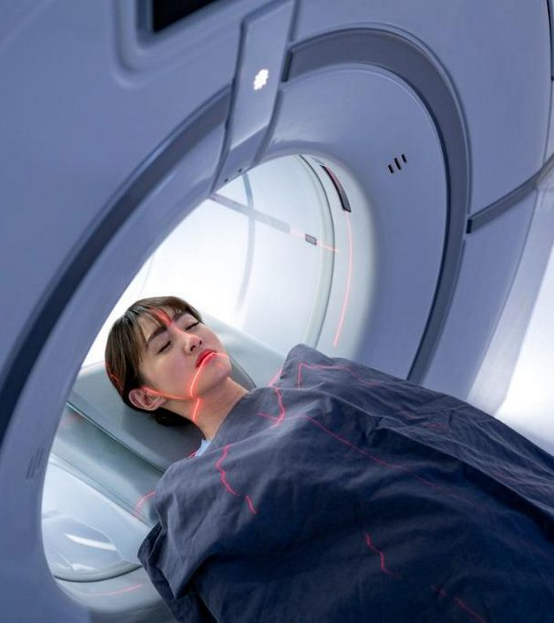

Automated Tumor Detection in Medical Images
Mentor – Dr. Parul Madan
Presentation by Asad Siddiqui Sec - A-rq Univ Roll No – 2021578

Slide 2
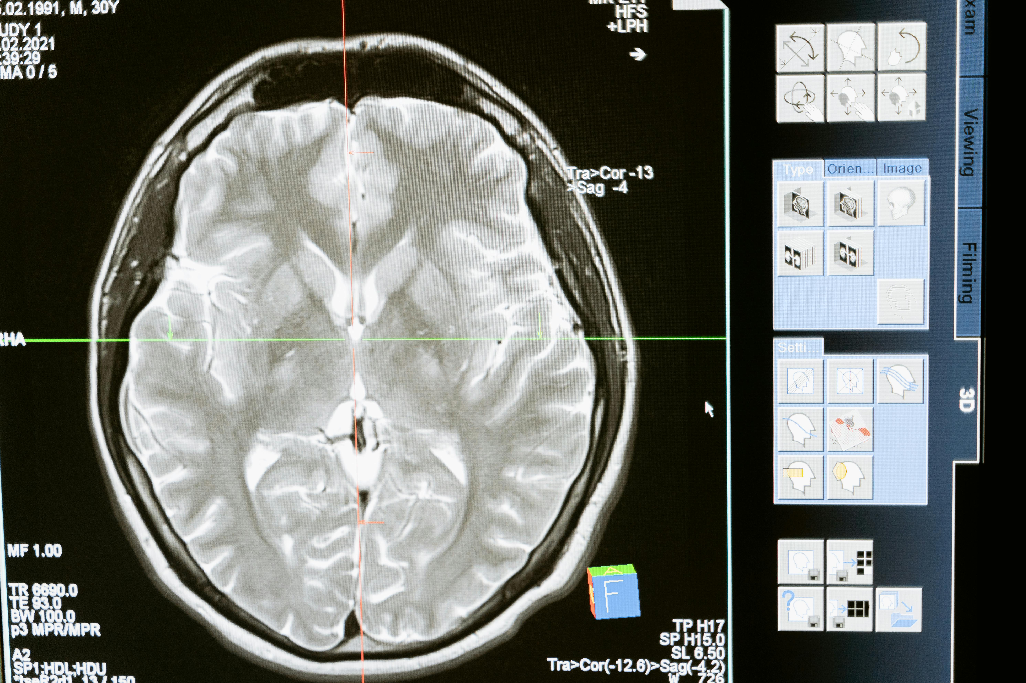
Overview of Image Classification
Computer Vision Foundation
Applications in Healthcare
Image classification categorizes images into labels, forming the foundation for many application across healthcare, automotive, and other sectors
In the healthcare industry, image classification is pivotal for tasks like diagnosing diseases such as brain tumors from medical images. Python frameworks like TensorFlow, Keras, and scikit-learn are commonly used for implementation.

Slide 3
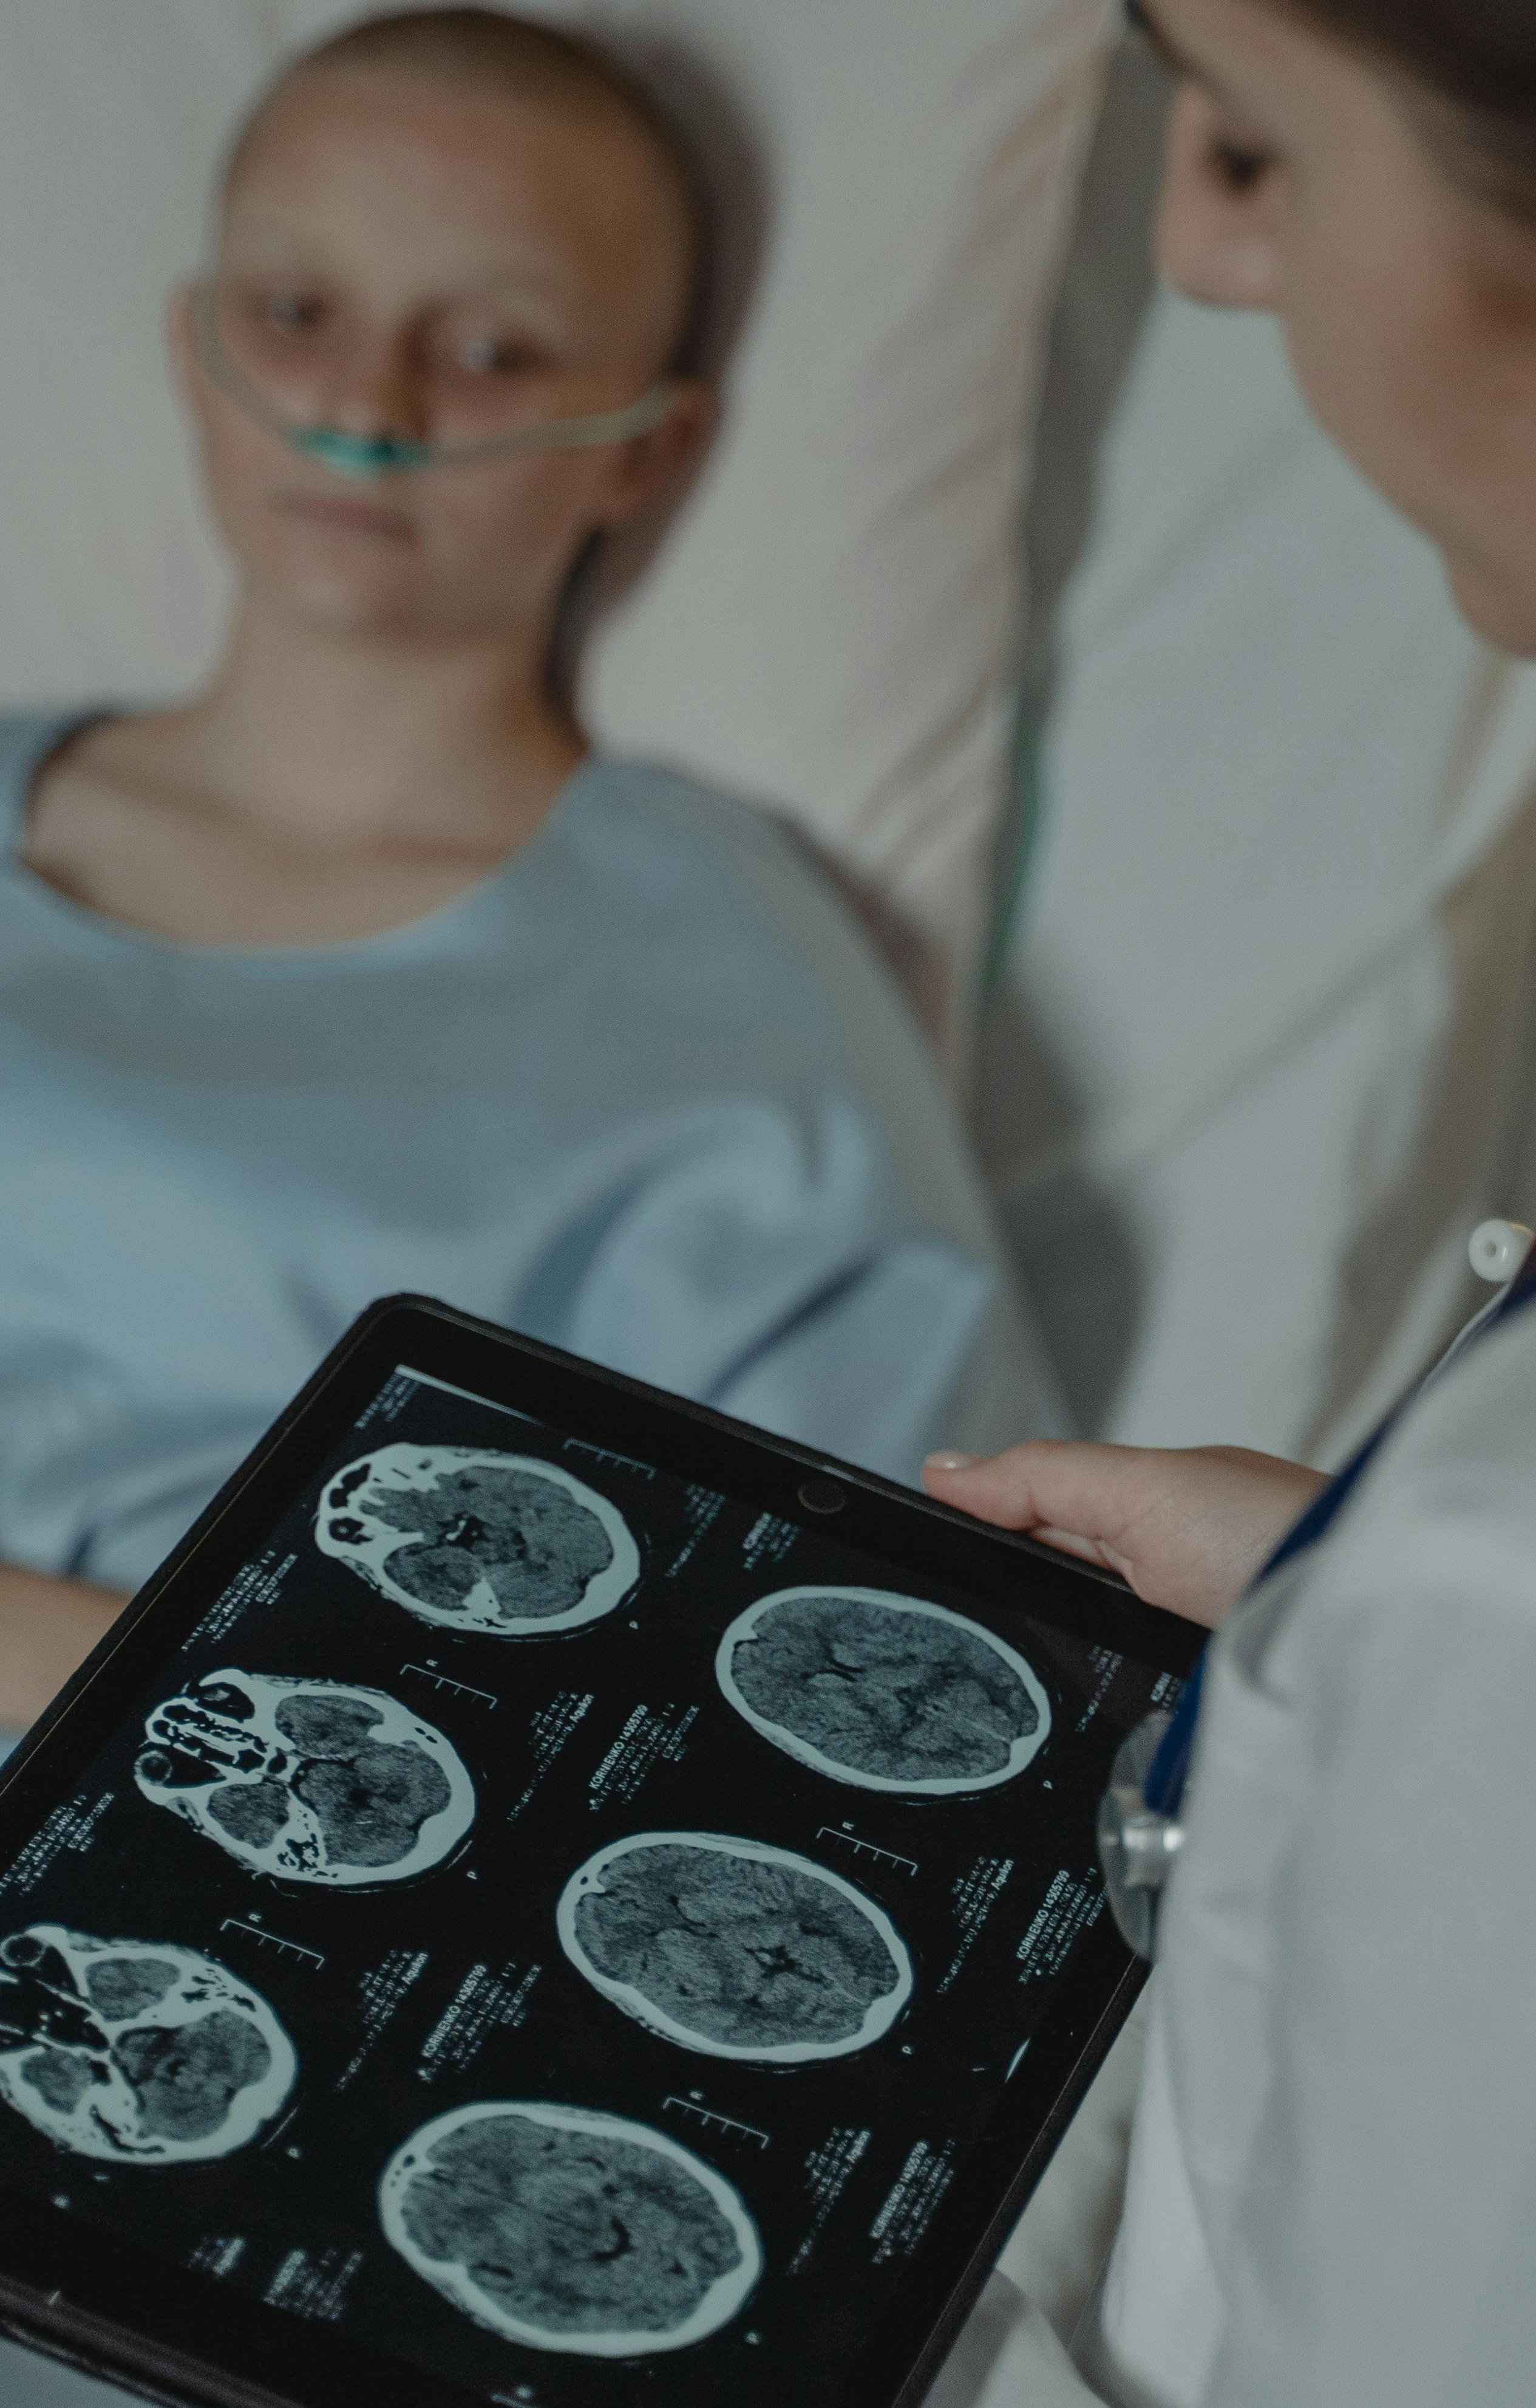
Overview of Brain Tumor
Types of Brain Tumors
Impact on Patient Health
Brain tumors encompass a variety of types, including Gliomas, Meningiomas, and Pituitary Tumors, each with distinct characteristics and treatment approaches.
Brain tumors pose significant health risks to patients, affecting cognitive functions, mobility, and overall quality of life. Early detection and accurate classification are crucial for timely intervention.

Slide 4

Advances in Brain Tumor Image Classification
Techniques for Classification
Advanced techniques like Convolutional Neural Networks (CNNs), Support Vector Machines (SVMs), and Random Forests have revolutionized brain tumor image classification by enhancing accuracy and efficiency.
Diagnostic Enhancement
These methods have significantly improved diagnostic precision by automating the process, reducing reliance on manual feature extraction, and enabling faster decision-making.

Slide 5
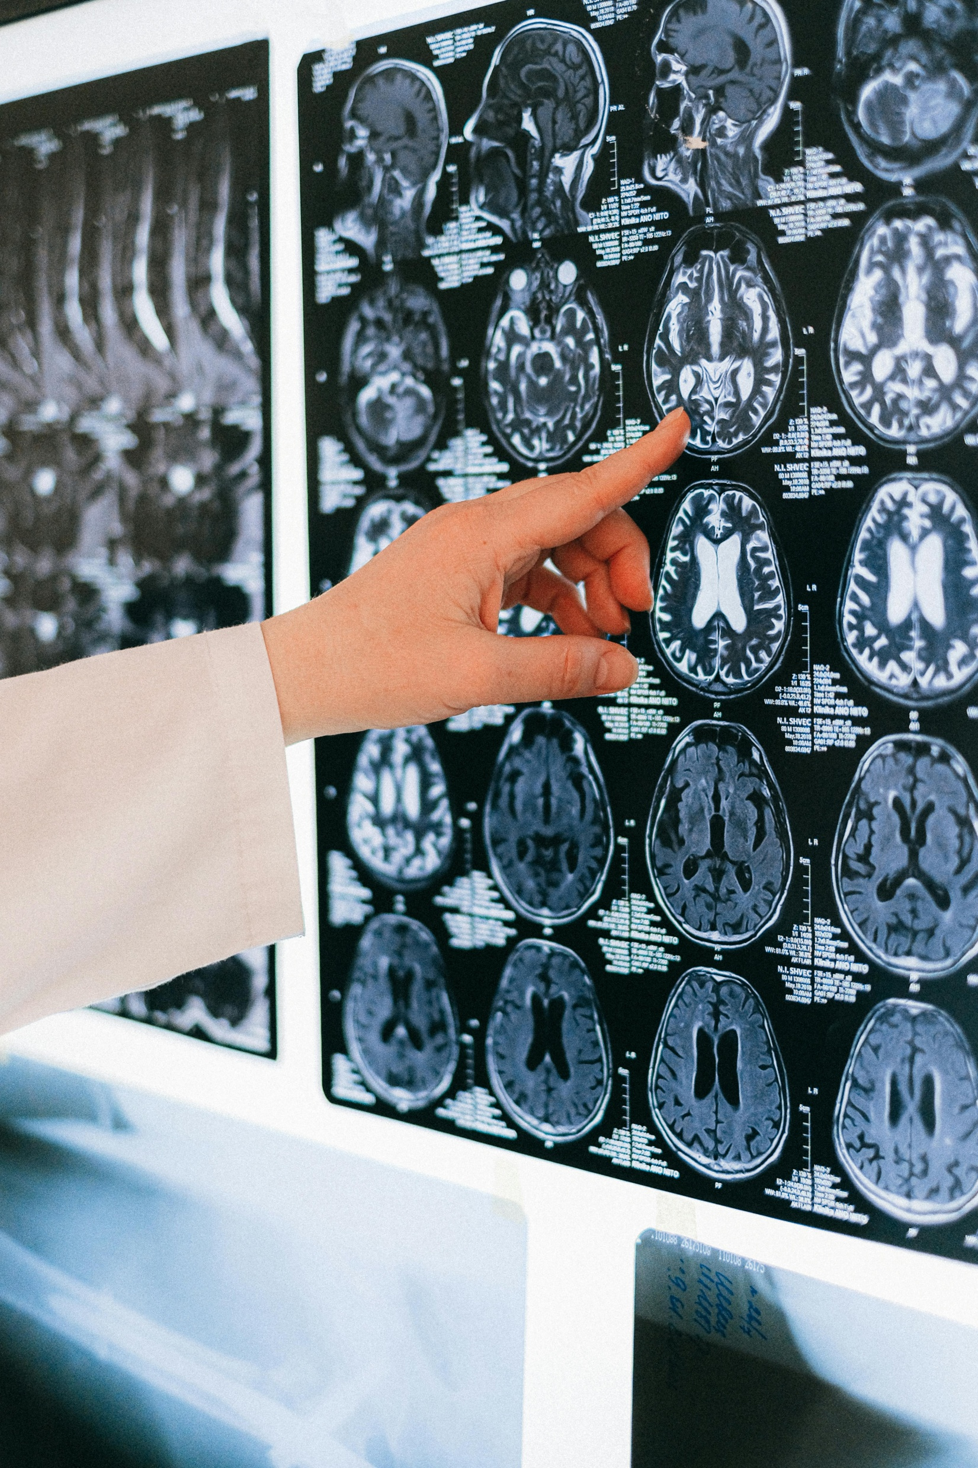
Methodology for Image Classification Using CNNs
Data Collection Process
Preprocessing
Classifying Tumor Types
Curating MRI images of brain tumors from sources like Kaggle to create a diverse and representative dataset for training and testing the CNN model.
Applying resizing, normalization, and data augmentation techniques like rescaling, rotation, and flipping to enhance the model's ability to learn variations in brain tumor images.
Utilizing CNN architecture to classify brain tumor images into categories such as Gliomas, Meningiomas, Pituitary Tumors, and non-tumor cases based on learned features.

Slide 6
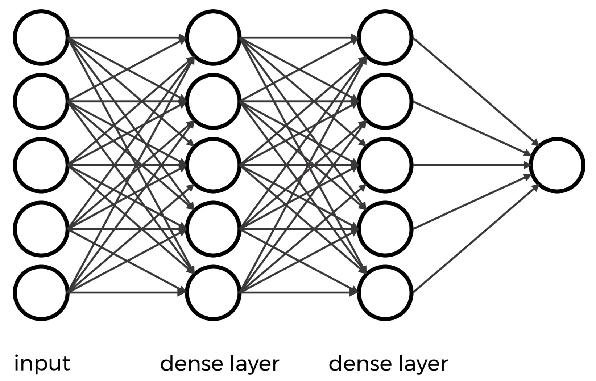
Model Architecture
CNN Structure
CNN model architecture uses convolutional and pooling layers for feature extraction and dense layers for classification in image tasks.

Slide 7
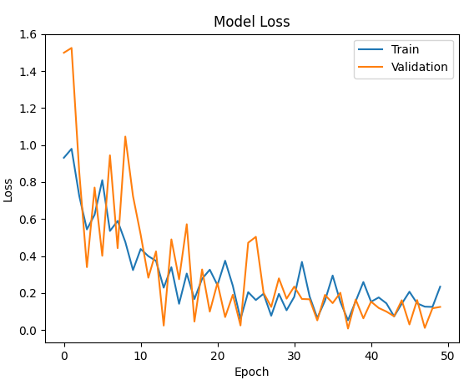
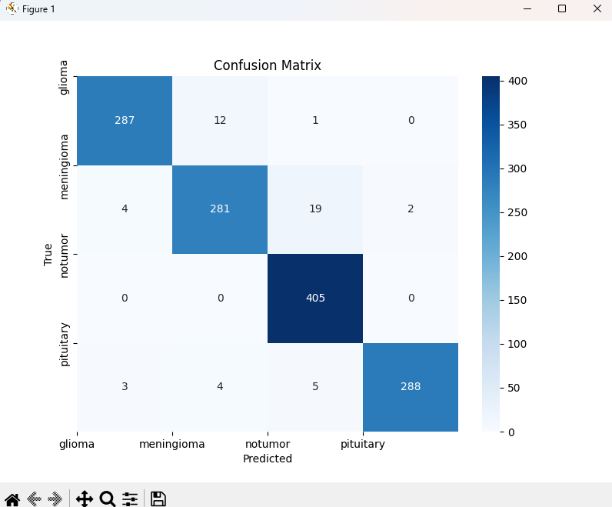
Model Training and Evaluation
Training Process
Visualization Techniques
Monitoring the model's accuracy and loss metrics across epochs to assess learning progress and make adjustments for improved performance.
Visualizing model results through tools like Confusion Matrix, accuracy, and loss graphs to gain insights into classification performance and potential areas for refinement.

Slide 8
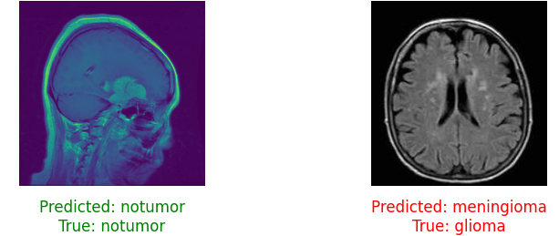
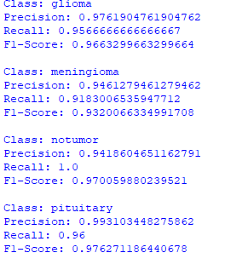
Results and Discussion
Classification Results
Presenting the overall accuracy and class-wise accuracy rates achieved by the CNN model for different brain tumor types, leading to a comprehensive discussion on performance outcomes.
Model Effectiveness
Analyzing the model's effectiveness in distinguishing between Gliomas, Meningiomas, Pituitary Tumors, and normal cases, showcasing its classification capabilities.

Slide 9

Conclusion and Future Directions
Key Findings
Future Work
Summarizing the high precision, recall, and F1-score attained by the CNN model in accurately classifying brain tumor images, indicating its robust performance.
Future work involves making the model stronger with different types of data, using existing knowledge from other tasks, and adding tools for immediate use in hospitals.

Slide 10

Thank You!
I hope you find my project valuable and informative

